Slide 1
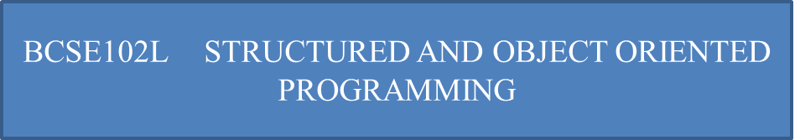

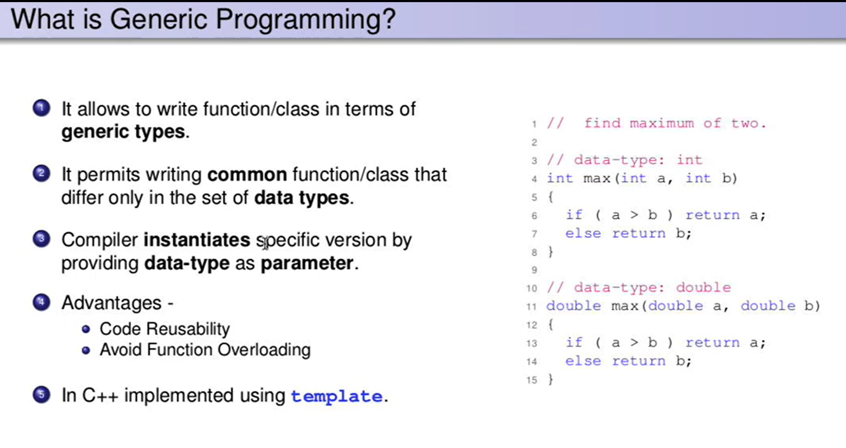
Generic Programming
Generic programming pattern generalizes the approach so that it may be used with a variety of data types.

Slide 2
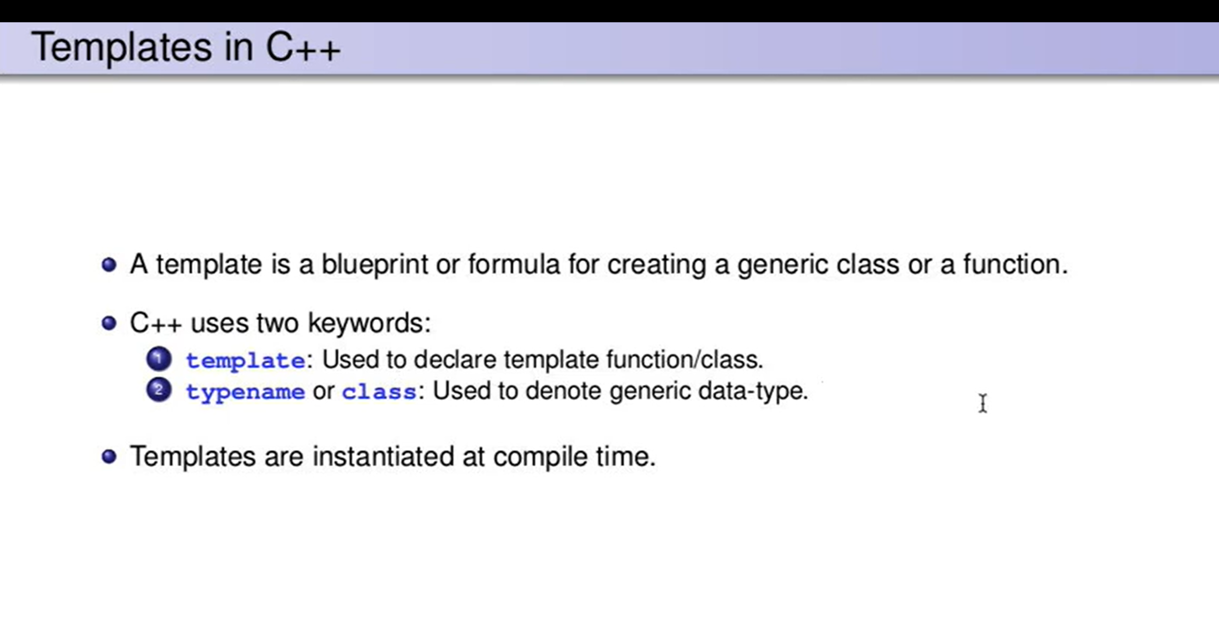

Slide 3
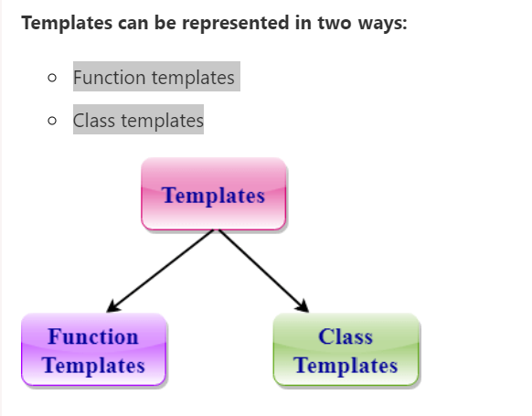
Generic Programming
collection of template classes and template functions that provide a generic way of programming.

Slide 4
Generic Programming
Function Templates:
We can define a template for a function.
For example, if we have an add() function, we can create versions of the add function for adding the int, float or double type values.

Slide 5
Generic Programming
Class Template:
We can define a template for a class.
For example, a class template can be created for the array class that can accept the array of various types such as int array, float array or double array.

Slide 6
Generic Programming
Syntax of Function Template
template<class Ttype> return_type fun_name(parameter list)
{
}

Slide 7
Generic Programming
Ttype: It is a placeholder name for a data type used by the function.
It is used within the function definition.
It is only a placeholder that the compiler will automatically replace this placeholder with the actual data type.
class: A class keyword is used to specify a generic type in a template declaration.

Slide 8
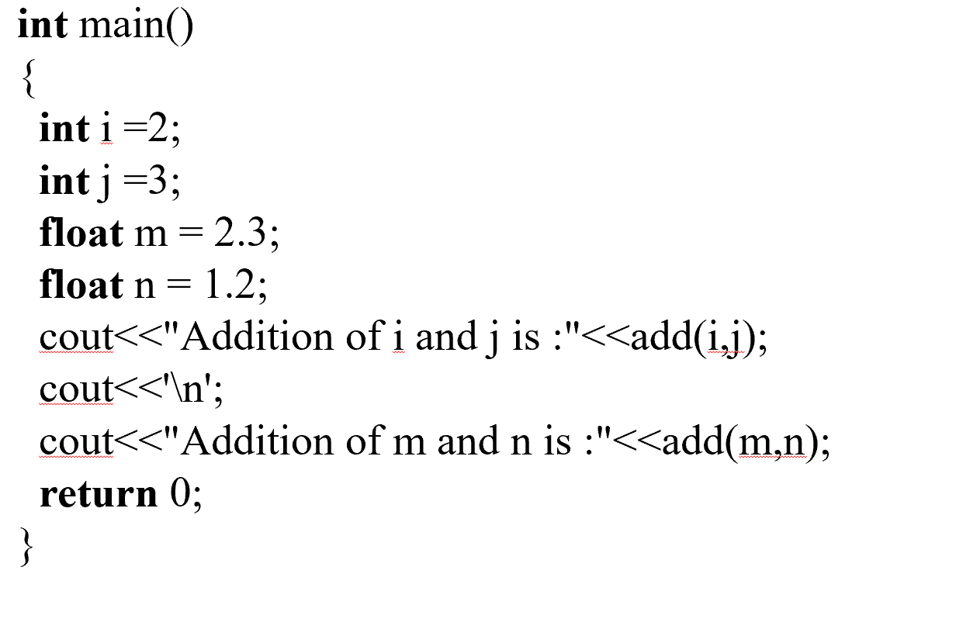
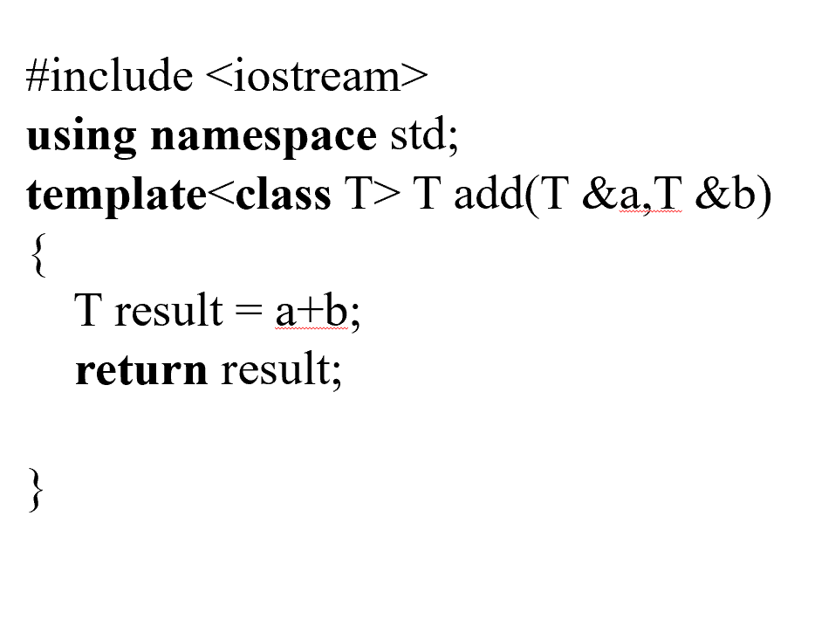
Generic Programming

Slide 9
Generic Programming
Output:
Addition of i and j is :5
Addition of m and n is :3.5

Slide 10
Generic Programming
Function Templates with Multiple Parameters
Syntax
template<class T1, class T2,.....>
return_type function_name (arguments of type T1, T2....)
{
// body of function.
}

Slide 11
Generic Programming
#include <iostream>
using namespace std;
template<class X,class Y> void fun(X a,Y b)
{
cout << "Value of a is : " <<a<< endl;
cout << "Value of b is : " <<b<< endl;
}
int main()
{
fun(15,12.3);
return 0;
}

Slide 12
Generic Programming
Output:
Value of a is : 15
Value of b is : 12.3

Slide 13
Value of a is : 15 Value of b is : 12.3
Generic Programming
Overloading a Function Template
#include <iostream>
using namespace std;
template<class X> void fun(X a)
{
cout << "Value of a is : " <<a<< endl;
}
template<class X,class Y> void fun(X b ,Y c)
{
cout << "Value of b is : " <<b<< endl;
cout << "Value of c is : " <<c<< endl;
}

Slide 14
Value of a is : 15 Value of b is : 12.3
Generic Programming
Overloading a Function Template
int main()
{
fun(10);
fun(20,30.5);
return 0;
}

Slide 15
Generic Programming
Output:
Value of a is : 10
Value of b is : 20
Value of c is : 30.5

Slide 16
CSE2008 NETWORK SECURITY
THANK YOU

